Slide 1
Research Internship Presentation: Colorectal Cancer Screening
Heather Smith, 4941932
MHS7991
University of Ottawa Telfer School of Management

Slide 2
BACKGROUND: CRC screening in the NWT

Slide 3
CRC attributed mortality in the NWT is nearly double that of Canada.
(CPAC, 2017)

Slide 4
Colorectal Cancer screening
Reduce cancer incidence and stage at presentation.
Improve survival.
Cost-effective.
Fecal Immunohistochemical Test (FIT)
(Coldman et al, 2017; CPAC, 2017; De Neer et al, 2018)

Slide 5
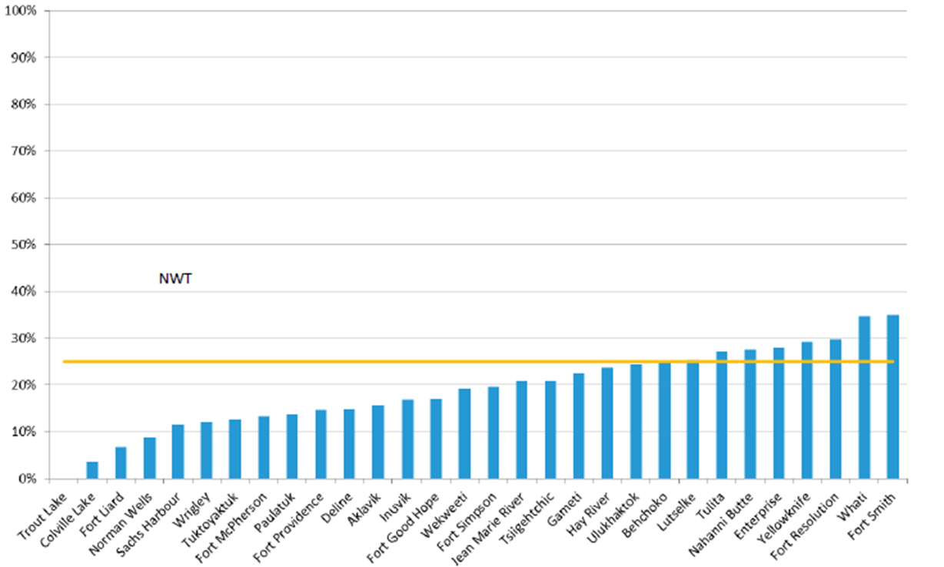
Low screening rates in the NWT
Currently opportunistic.
National Target = 60%
NWT overall 22%
(NTHSSA, 2016)

Slide 6
MY ROLE
How many colonoscopies are needed?
Help to inform effective delivery of cancer screening in the complex rural and remote health system of the NWT.
Notes:
NTT

Slide 7
THE WORK
5 months placement at the Office of the Chief Public Health Officer (Dr. Kandola).
Participate in screening program planning,
Analyzed in screening delivery,
Conceptual diagram of screening,
Taught indigenous patient advocates the importance of screening.
Notes:
Studied examples of colonoscopy delivery from other regional screening programs.
Conceptual diagram of screening in the NWT with patients, providers, and administrator.
Site visit to Inuvik to teach indigenous patient advocates the importance of screening.

Slide 8
KEY LEARNING: System complexity

Slide 9
KEY LEARNING: Role of HI
Health informatics is critical to health system capacity.
Opportunity for synchronizing collaboration by optimizing E-health.

Slide 10
KEY LEARNING: Rural research
Understand the importance of collaborators in conducting rural research.
Overcoming challenges of conducting research in rural health systems.

Slide 11
Summary
Excellent learning opportunity to understand the role of research in understanding health system complexity and informing effective delivery.

Slide 12
Mársı | Kinanāskomitin | Thank you | Merci | Hąį’ | Quana | Qujannamiik | Quyanainni | Máhsı | Máhsı | Mahsı̀

Slide 13
References
Champion C, Alvarez G, Affleck E, Kuziemsky C, (2017) A systems approach to rural and remote colorectal cancer screening access ,Journal of Cancer Policy, 14:27-32
Canadian Partners Against Cancer. Colorectal cancer screening in Canada: Environmental Scan [Internet]. cancerview.ca. 2017 [cited 2018 Nov 18]. Available from: http://www.cancerview.ca/preventionandscreening/colorectalcancerscreeningpage/
Coldman A, Flanagan W, Nadeau C, Wolfson M, Fitzgerald N, Memon S, et al. Projected effect of fecal immunochemical test threshold for colorectal cancer screening on outcomes and costs for Canada using the OncoSim microsimulation model. Journal of Cancer Policy. 2017 Sep 1;13:38–46.
Fung-Kee-Fung M, Goubanova E, Sequeira K, Abdulla A, Cook R, Crossley C, et al. Development of communities of practice to facilitate quality improvement initiatives in surgical oncology. Qual Manag Health Care. 2008 Jun;17(2):174–85.
Moberg J, Oxman AD, Rosenbaum S, Schünemann HJ, Guyatt G, Flottorp S, et al. The GRADE Evidence to Decision (EtD) framework for health system and public health decisions. Health Research Policy and Systems. 2018 May 29;16(1):45.
Northwest Territories Department of Health and Social Services. (2016) Colorectal Cancer Screening Rates in NWT. Yellowknife: NWT Department of Health and Social Services.
Northwest Territories Department of Health and Social Services. (2015) Charting Our Course: Northwest Territories Cancer Strategy 2015-2025. Yellowknife: NWT Department of Health and Social Services.
Swartz AW, Eberth JM, Josey MJ, Strayer SM. (2017) Re-analysis of All-Cause Mortality in the U.S. Preventive Services Task Force 2016 Evidence Report on Colorectal Cancer Screening. Ann Intern Med. [Epub ahead of print 22 August 2017] doi: 10.7326/M17-0859

